Slide 1

의료정보학시스템
Device on FHIR 1
Dept. of Computer Science & Engineering
College of IT
Kyungpook National University
2017.10.23.

Slide 2
DoF 프로파일 개요
DoF(Device on FHIR)는 HL7 FHIR 리소스 및 프로파일을 활용하여, 의미적으로 일관성 있는 의료기기 정보교환을 보장하기 위한 공동협력의 결과물이다. (Devices on FHIR is a collaborative effort to ensure semantically consistent device information exchange whether achieved using current HL7 FHIR-based resource & profiles)

Slide 3

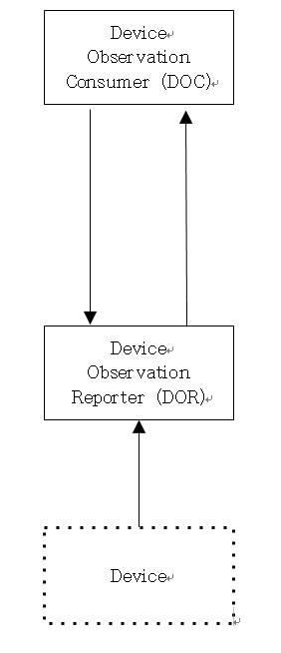
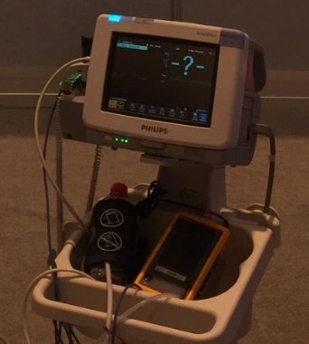
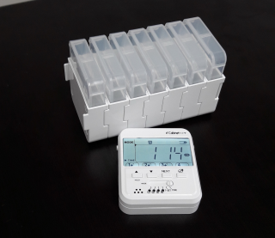
DoF Transaction

Slide 4
Resources
DeviceComponent
<MDS>
source
Device
parent
source
DeviceComponent
<VMD>
source
source
parent
DeviceComponent
<CHAN>
parent
DeviceMetric
device
Observation
Patient
subject

Slide 5



DoF Client development

Slide 6
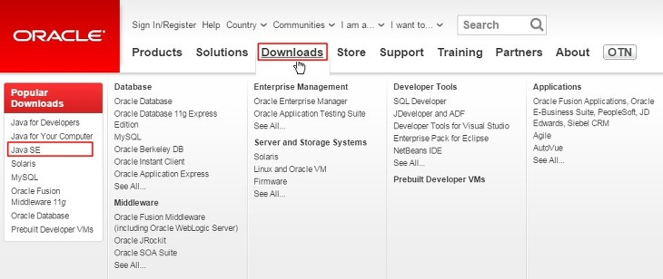
Install JAVA
http://www.oracle.com/index.html

Slide 7
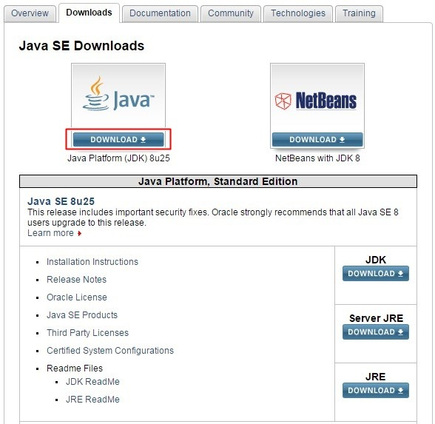
Install JAVA

Slide 8
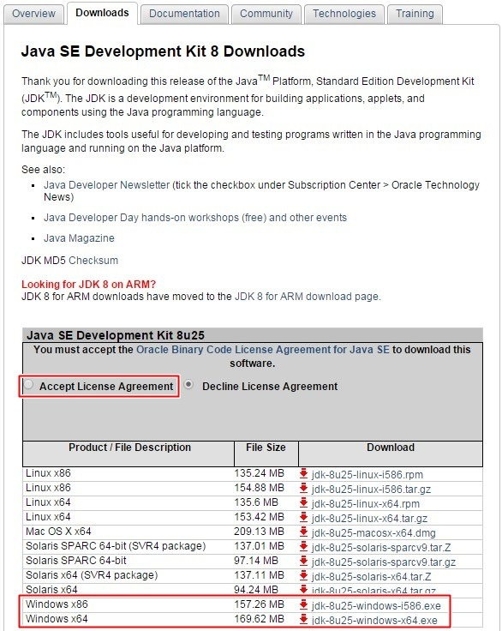
Install JAVA

Slide 9
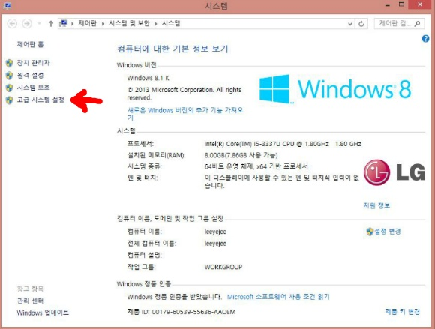
자바 환경변수 설정
사용하는 PC의 속성창
윈도우8.1기준으로 '제어판->시스템 및 보안-> 시스템'

Slide 10
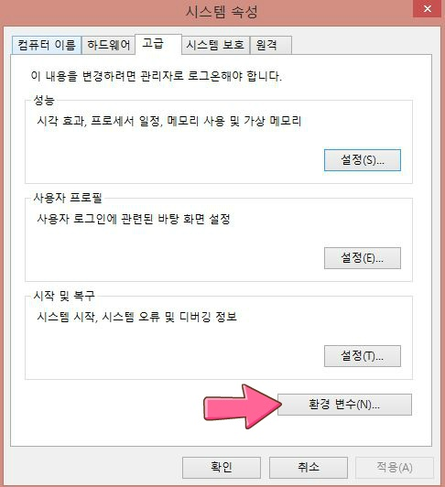
Install JAVA

Slide 11
Install JAVA

Slide 12
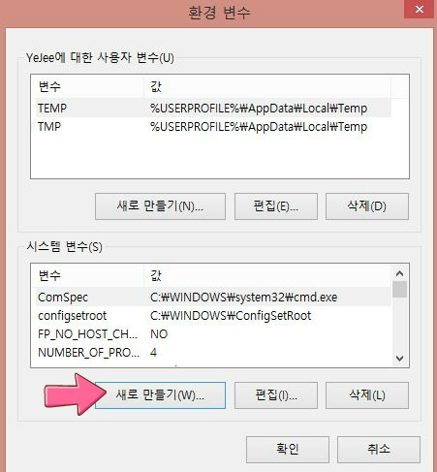
Install JAVA

Slide 13
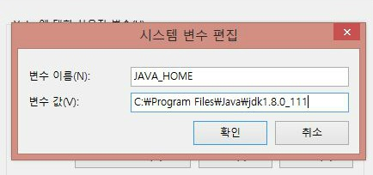
Install JAVA

Slide 14

Install JAVA

Slide 15
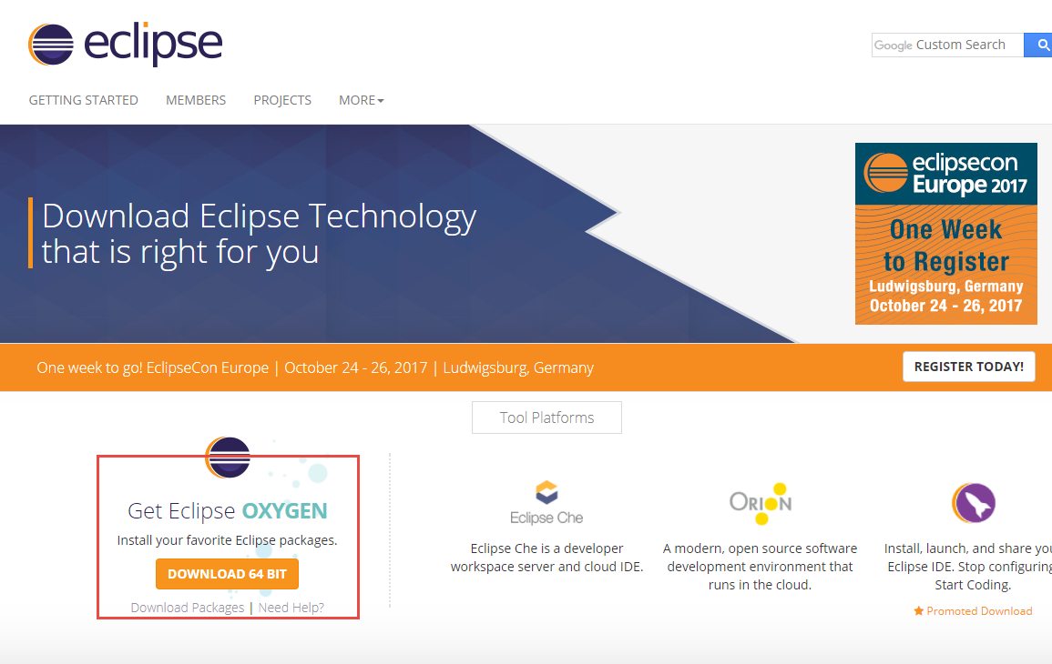
Install Eclipse
http://www.eclipse.org/downloads/

Slide 16
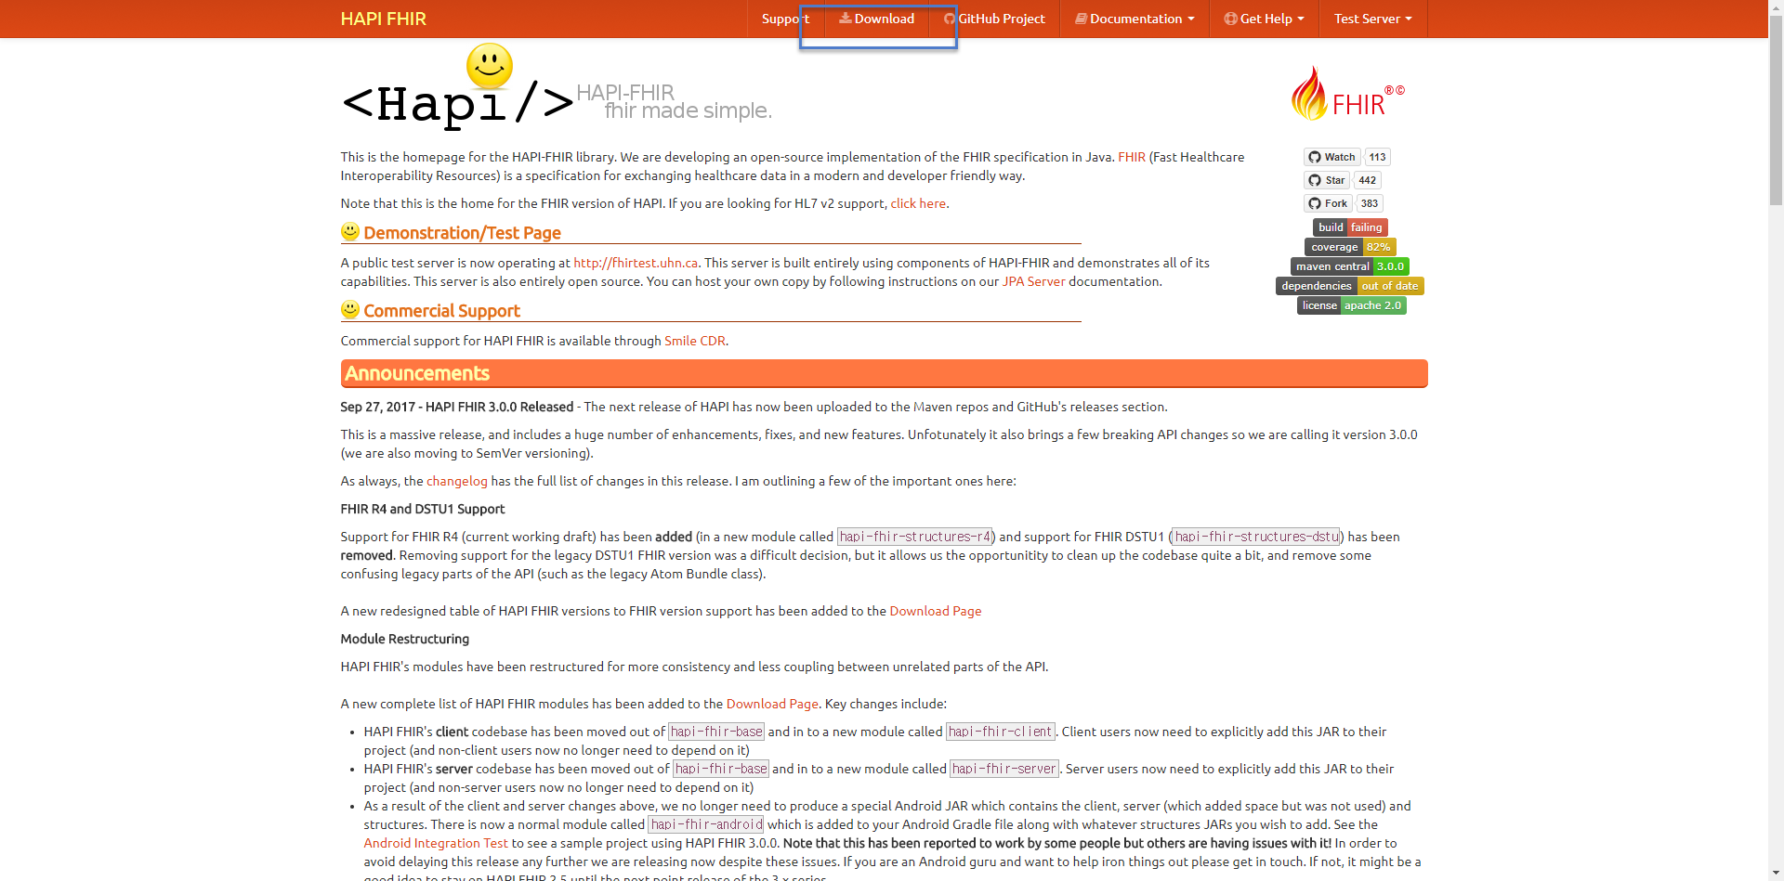
Download Hapi FHIR for JAVA
http://hapifhir.io/

Slide 17
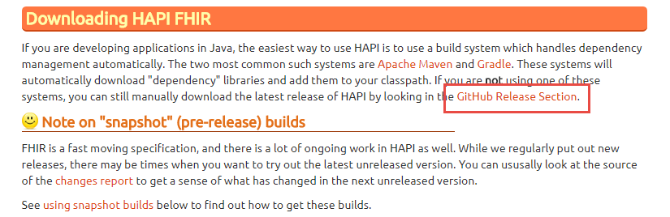
Download Hapi FHIR for JAVA

Slide 18
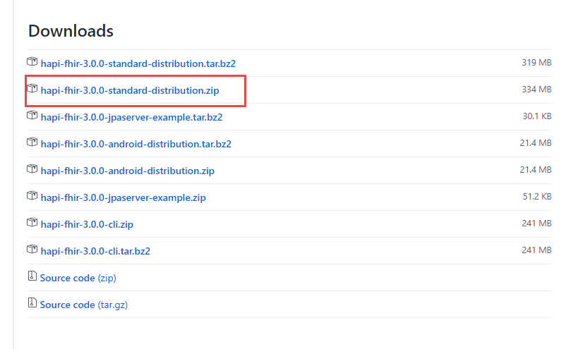
Download Hapi FHIR for JAVA

Slide 19
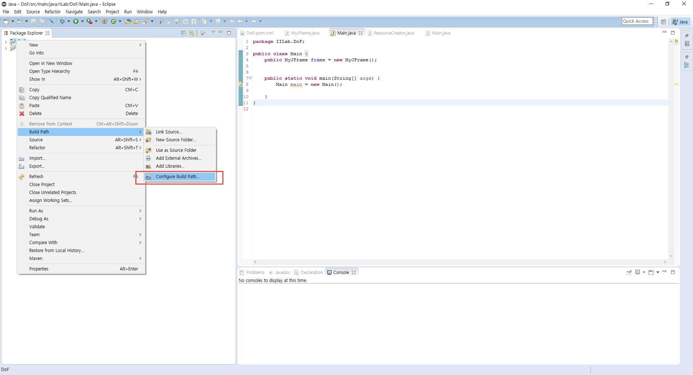
Download Hapi FHIR for JAVA

Slide 20
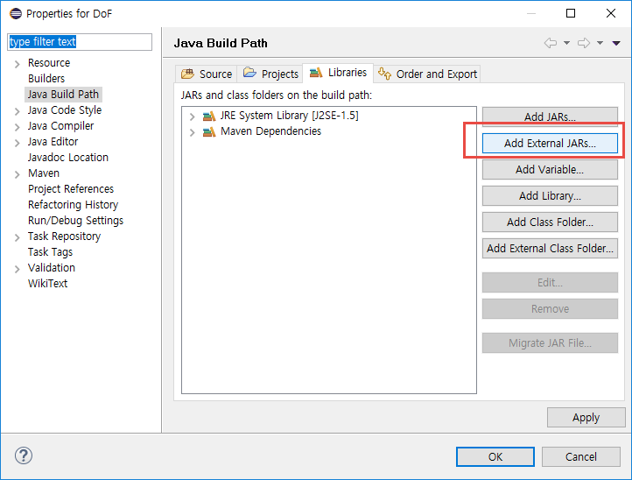
Download Hapi FHIR for JAVA

Slide 21
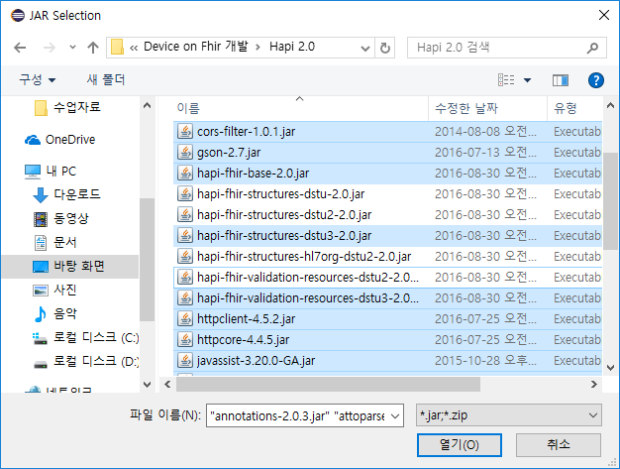
Download Hapi FHIR for JAVA

Slide 22
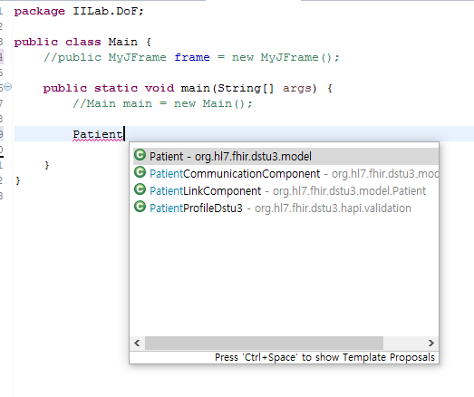
Make Resource

Slide 23
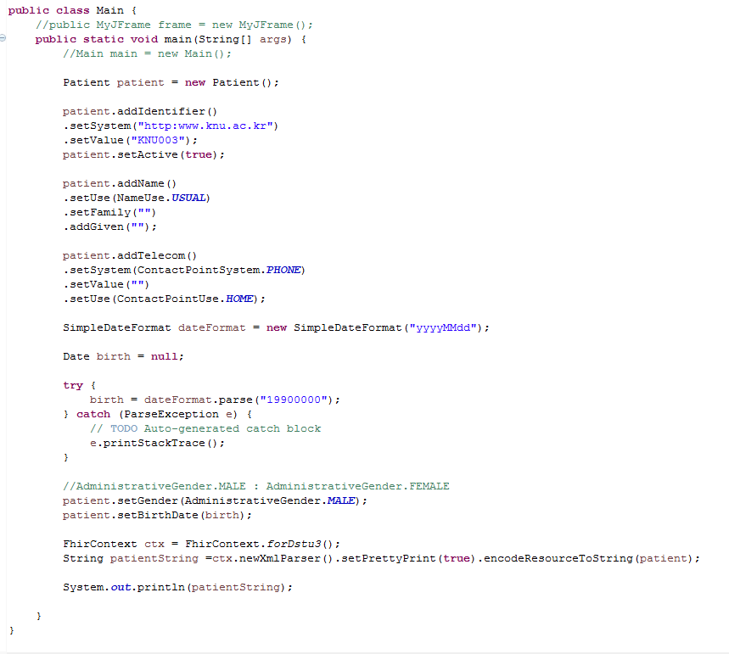
Make Resource

Slide 24
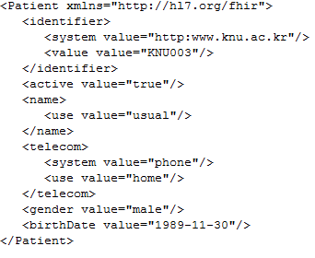
Make Resource
자신의 이름 전화번호 등을 기입하여
제출하세요.

Slide 25
Make Resource
Assignment
Input your phone number, name, and date of birth.
Submit your source code and captured image

Slide 26
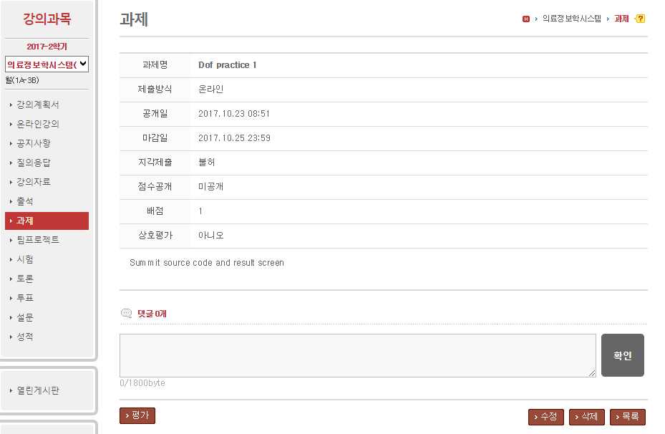
Summit page
lms.knu.ac.kr

Slide 28


